Slide 1
PSO Week 12
CS448 Staff

Slide 2
Concurrency Control
Multiple Granularity
The Phantom Phenomenon

Slide 3
Why Granularity?
T1 that needs to access the entire database
T1 must lock each item in the database
Less efficient
a single lock to lock the entire database
T2 access a few data items from a database
Unnecessary to lock the entire database
Loss of Concurrency
Granularity
Tradeoff between Efficiency and Concurrency

Slide 4
Multiple Granularity
Granularity
the size of data item allowed to lock
Multiple Granularity
hierarchically breaking up the database into blocks
Blocks
can be locked and can be track what need to lock and in what fashion

Slide 5
Multiple Granularity
Node
database
area
file
record
DB
A1
A2
Fa
Fb
Fc
ra1
ra2
. . .
ran
rb1
. . .
rbk
rc1
. . .
rcm

Slide 6
Multiple Granularity
Each node can be locked individually
2-phase locking protocol
Lock a node in shared or exclusive mode
Implicitly locks all the descendants of that node in the same lock mode
DB
A1
A2
Lock
Fa
Fb
Fc
Fc
Implicitly lock
ra1
ra2
ran
rb1
rbk
rc1
rc1
rcm
. . .
. . .
. . .
rcm
Notes:
For example, if transaction Ti gets an explicit lock on file Fc in exclusive mode, then it has an implicit lock in exclusive mode on all the records belonging to that file. It does not need to lock the individual records of Fc explicitly.

Slide 7
Intention Mode Lock
Intention-Shared (IS): explicit locking at a lower level of the tree but only with shared locks.
Intention-Exclusive (IX): explicit locking at a lower level with exclusive or shared locks.
Shared & Intention-Exclusive (SIX): the sub-tree rooted by that node is locked explicitly in shared mode and explicit locking is being done at a lower level with exclusive mode locks.

Slide 8
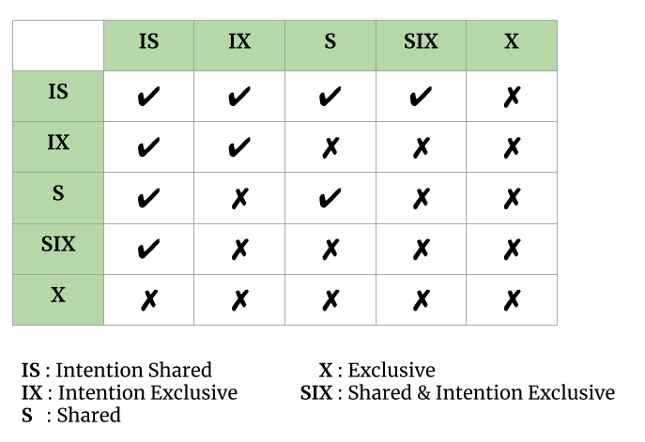
2-Phase Multiple Granularity Locking Protocol
Ti must follow the lock-compatibility matrix.
Locks are acquired in top-down (root-to-leaf) order
Locks are released in bottom-up (leaf to-root) order
Compatibility Matrix

Slide 9
2-Phase Multiple Granularity Locking Protocol
Ti must follow the lock-compatibility matrix.
Transaction Ti must lock the root of the tree first, and it can lock it in any mode.
Transaction Ti can lock a node in S or IS mode only if Ti currently has the parent of the node locked in either IX or IS mode.
Transaction Ti can lock a node in X, SIX, or IX mode only if Ti currently has the parent of the node locked in either IX or SIX mode.
Transaction Ti can lock a node only if Ti has not previously unlocked any node (i.e., Ti is two phase).
Transaction Ti can unlock a node only if Ti currently has none of the children of the node locked.
Compatibility Matrix

Slide 10
Examples of Multiple Granularity
T1 reads a record in ra2.
T2 modifies a record ra9.
T3 reads all records in Fa.
T4 reads the entire database.
DB
A1
A2
Fa
Fb
Fc
ra1
ra2
. . .
ran
rb1
. . .
rbk
rc1
. . .
rcm

Slide 11
Examples of Multiple Granularity
T1 reads a record in ra2.
T2 modifies a record ra9.
T3 reads all records in Fa.
T4 reads the entire database.
 | T1 | T2 | T3 | T4
DB | IS | IX | IS | S
A1 | IS | IX | IS
Fa | IS | IX | S
ra2 | S
ra9 |  | X

Slide 12
Examples of Multiple Granularity
 | T1 | T2 | T3 | T4
DB | IS | IX | IS | S
A1 | IS | IX | IS
Fa | IS | IX | S
ra2 | S
ra9 |  | X
T1, T3 and T4 can access the database concurrently
T2 can execute concurrently with T1, but not with either T3 or T4.
Compatibility Matrix

Slide 13
Time |  | T1 | T2 | T3 | T4
1 | DB | IS
2 | A1 | IS
3 | Fa | IS
4 | ra2 | S
5 | DB |  | IX
6 | DB |  |  | IS
7 | A1 |  |  | IS
8 | Fa |  |  | S
9 | A1 |  | IX
10 | Fa |  | IX
11 | DB |  |  |  | S
2: T1:IS
7: T3:IS
9: T2:IX
1: T1:IS
5: T2:IX
6: T3:IS
11: T4:S
3: T1:IS
8: T3:S
9: T2:IX
DB
A1
A2
Fa
Fb
Fc
ra1
ra2
...
ran
rb1
...
rbk
rc1
...
rcm
4: T1:ra2

Slide 14
The Phantom Phenomenon (Independent to Multiple Granularity)
Consider following two transactions
T1: select count(*) from instructor where dept_name = 'Physics' ;
T2: insert into instructor values (11111, 'Feynman', 'Physics', 94000);
What happens
If T1 uses the tuple newly inserted by T2 in computing count(*), then T2 comes first.
If T1 does not use the tuple newly inserted by T2 in computing count(*), then T1 comes first.
T1 and T2 do not access any tuple in common
T1 and T2 conflict with each other, on a phantom tuple
Undetectable at the tuple granularity

Slide 15
How to Detect the Phantom Phenomenon
T1 find all instructor tuples with dept_name = “Physics”
T1 search either the whole instructor relation, or at least an index including column “dept_name”
T2 Insert a new tuple into the relation
T2 update the index including column “dept_name”
T1 and T2 conflict on the the information used to find the tuples
Solution
Lock the tuples that are accessed
Lock data item corresponding to the relation
Index-locking Protocol

Slide 16
Index-locking Protocol
Turn instances of the phantom phenomenon into conflicts on locks on index leaf nodes
Protocol:
Every relation must have at least one index.
Ti can access tuples of a relation only after first finding them through one or more of the indices on the relation.
A relation scan = scan all the leaves of one of the indices
If Ti performs a lookup, then Ti must acquire a shared lock on all the index leaf nodes that it accesses.
If Ti insert, delete, or update a tuple in a relation, then Ti must update all affected indices on relation.
For insertion and deletion, the leaf nodes affected are those that contain (after insertion) or contained (before deletion) the search-key value of the tuple.
For updates, the leaf nodes affected are those that (before the modification) contained the old value of the search key, and nodes that (after the modification) contain the new value of the search key
Follow the 2-phase locking protocol for both tuples and indices.

Slide 17
Reference
Multiple Granularity Locking in DBMS (https://www.geeksforgeeks.org/multiple-granularity-locking-in-dbms/)
Database System Concepts 7th Edition Chapter 18.3-18.4

Slide 18
Thank You!

